Slide 1
SPORTS news portal
Project by: Md Norul Gofran
Amisse Manuel Joao
Esrael Asrat Bobo

Slide 2
What is Sports Mania?
Sports Mania is a free android application which helps android phone users to read latest sports news before anyone else.

Slide 3
Why Sports news portal ?
Staying up to date with the juiciest and latest sports news headlines was never so easy.
Browse through latest sports news headlines with a swipe of your thumb and click on the articles you want to read.

Slide 4
Lacking of quality news.
Want to create a platform for the sports maniac.

Slide 5
What is the scope of sport news portal ?
Users can save news’s for offline reading.
A very user friendly searching area in the application.
Users can easily share the news on social media via the social media sharing icon provided on the app.

Slide 6
Can search news only on certain categories.
Added dark mode.
Added data saving features.
Added reaction button.

Slide 7
Work done so far…
Project environment is created.
Analysis and design.
Android application

Slide 8
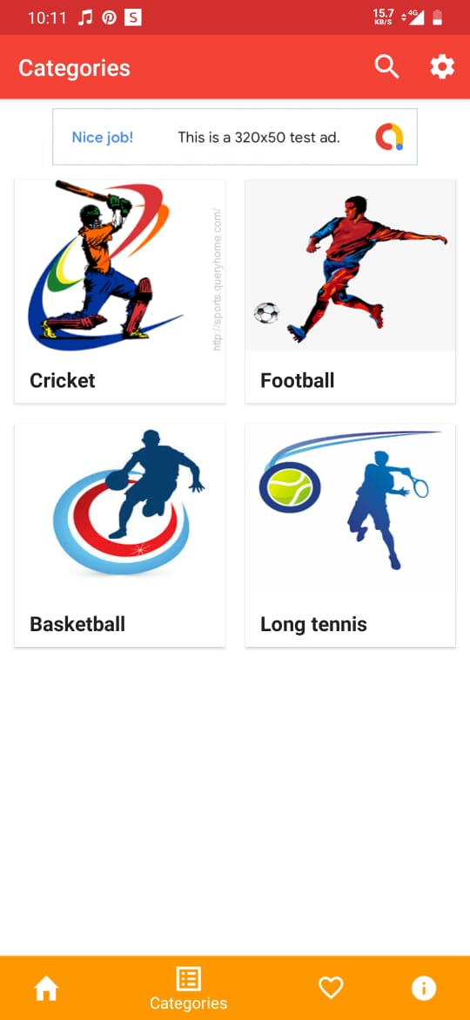

Slide 9
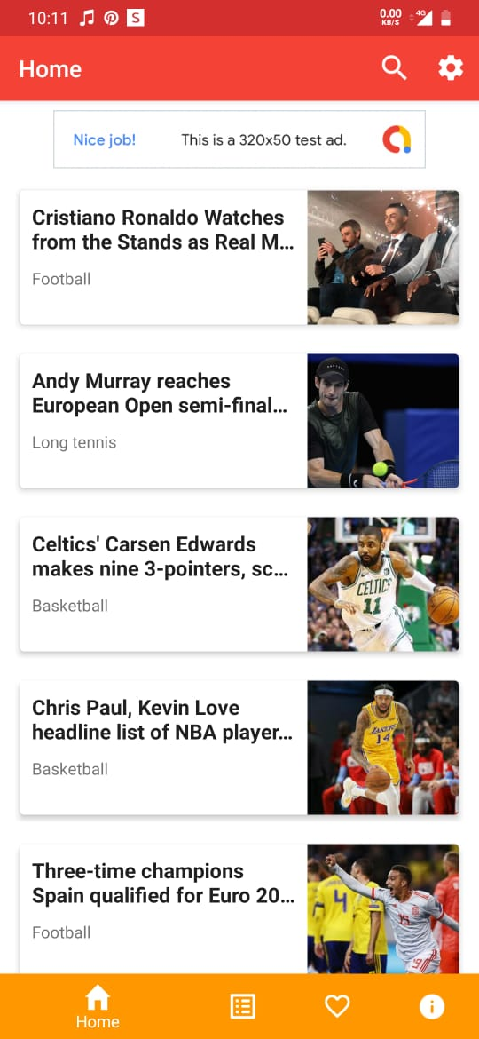

Slide 10
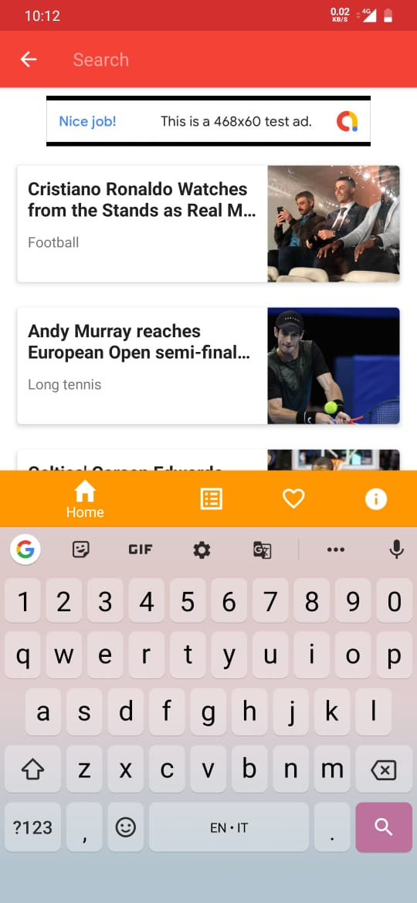

Slide 11
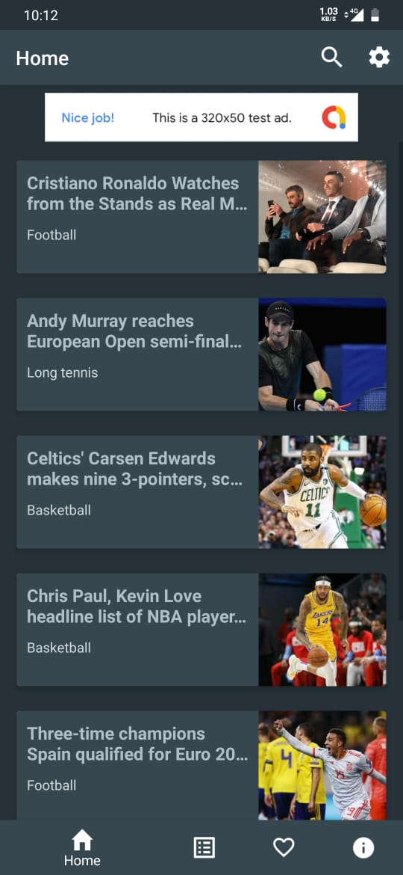

Slide 12
THANK YOU!

